Slide 1

Coal Mine Safety Monitoring And Alerting System
by
S Sai Varshitha
Roll No. 224G1A3282
B Uday Kiran Reddy
Roll No. 234G5A3212
C Samreen
Roll No. 224G1A3283
L Badrinath
Roll No. 234G5A3203
Under the guidance of
Mr. Dr. G. Hemanth Kumar Yadav _{M. Tech, PhD}
Assistant Professor
Department of Computer Science and Engineering (Data Science)
Srinivasa Ramanujan Institute of Technology
(Affiliated to JNTUA & Approved by AICTE) (Accredited by NAAC with ‘A’ Grade & Accredited by NBA (EEE, ECE & CSE)
Rotarypuram Village, B K Samudram Mandal, Ananthapuramu – 515701.
2025 - 2026

Slide 2
Abstract
Coal mining is a highly hazardous industry, with dangers such as toxic gases, high temperatures, and communication failures, where traditional safety systems often fail to provide real-time alerts for sudden disasters. This research develops an IoT-based safety monitoring and alert system designed to address life-threatening hazards including methane (CH₄), carbon monoxide (CO), oxygen deficiency, excessive heat, and fire. The system ensures continuous underground monitoring and instant alerts when unsafe thresholds are detected, while enabling cloud-based data storage and remote supervision through web and mobile applications. It integrates MQ-series gas sensors, DHT22, and pressure sensors with an ESP32/Arduino microcontroller, transmitting collected data via Wi-Fi or GSM to a cloud dashboard for live monitoring. Results demonstrate that the system effectively detects unsafe conditions in real time, triggers immediate alerts, and allows remote supervision, thereby enhancing miner safety and reducing accidents. Overall, IoT technology offers a scalable and reliable solution for improving coal mine safety through real-time hazard detection, accident prevention, and better protection of workers in hazardous environments.

Slide 3

Contents
Abstract
Introduction
Literature survey
Proposed Work
References
GitHub Link
Queries

Slide 4
Introduction
Coal mining hazards – Coal mines are prone to toxic gases, high temperatures, oxygen deficiency, and communication failures, making miner safety a major concern.
Limitations of traditional systems – Existing safety systems often fail to provide real-time monitoring and instant alerts during emergencies.
Need for smart solutions – Continuous monitoring and quick detection of unsafe conditions are essential to prevent accidents and protect miners.
Role of IoT – IoT technology enables real-time data collection, cloud storage, and instant notifications through web and mobile applications.
Project aim – This project proposes an IoT-based coal mine safety monitoring system that ensures real-time alerts, improves supervision, and enhances miner safety.

Slide 5
Literature Survey
No | Title | Author | Journal Name & Year | Methodology Adapted | Key Findings | Gaps
1 | Coal Mine Monitoring & Alerting System with Smart Helmet | Gopi Setty, Ramesh, Satish Bojjawar | IJARCCE & 2025 | This research represents ZigBee based WMS using a Smart Helmet | Coal mine Safety, Monitoring System, IoT, ZigBee, Smart Helmet. | Dependence on ZigBee only. Introducing LoRa for more efficient in deep underground Conditions.
2 | Advanced Coal Mine Safety Monitoring & Auto Alert System using LoRa technology | N. Lakshmi pathi & Amit Arora | CVR Journal Of Science and Technology (2022) | Our device monitors coal mine conditions using NodeMCU ESP8266 with LoRa communication. | Monitoring via LoRa/ESP8266,sending emails & data to Thing Speak, includes,tempera-ture, gas detector etc. | It lacks integration with automated emergency response mechanisms.
3 | Coal Mine Safety Monitoring System Using LoRa cloud | W. Akram | SSRN 2022 | This system uses Arduino UNO connected via LoRa for monitoring and alerts | Monitors environmental conditions in real time, enables remote monitoring | Limited to prototype testing without large scale validation or integration of advanced analytics

Slide 6
Proposed System
live monitoring through web and mobile applications, ensuring continuous supervision.
Real-time Environmental Monitoring: The system is designed to continuously monitor underground conditions in real time, including toxic gases like methane (CH4​) and carbon monoxide (CO), as well as temperature, humidity, and air pressure
Sensor and Microcontroller Integration: It uses various sensors, specifically MQ-series gas sensors, a DHT22 sensor for temperature and humidity, and pressure sensors, all connected to an ESP32/Arduino microcontroller.
Data Transmission to the Cloud: The collected real-time data from the sensors is transmitted via Wi-Fi or GSM to a cloud-based dashboard
Instant Alerts and Live Supervision: The system is designed to trigger instant alerts when unsafe thresholds are detected. This allows for live monitoring through web and mobile applications, ensuring continuous supervision.
Enhanced Miner Safety: By providing continuous monitoring and immediate alerts, the system's primary objective is to reduce accidents and improve the overall safety of miners.

Slide 7
Reference
[1]. Thilaga raj M, R Krishna Kumar and Krishna Raj N, “Design and implementation of Coal Mine Safety Monitoring and Alerting System using IoT” International Journal Of Modern Agriculture, vol. 10, NO.2(2021).
[2]. P. Sawant, S. Godse and K Kasar “Arduino Based Smart Helmet For Coal Mine Safety” SSRN Electron vol.9, NO.4(2020).
[3]. Anand Viswa Karma, Animesh Yash and Anishka Singh, “IoT Mining Tracking & Worker Safety Helmet” IJRASET vol.12,(2024).

Slide 8
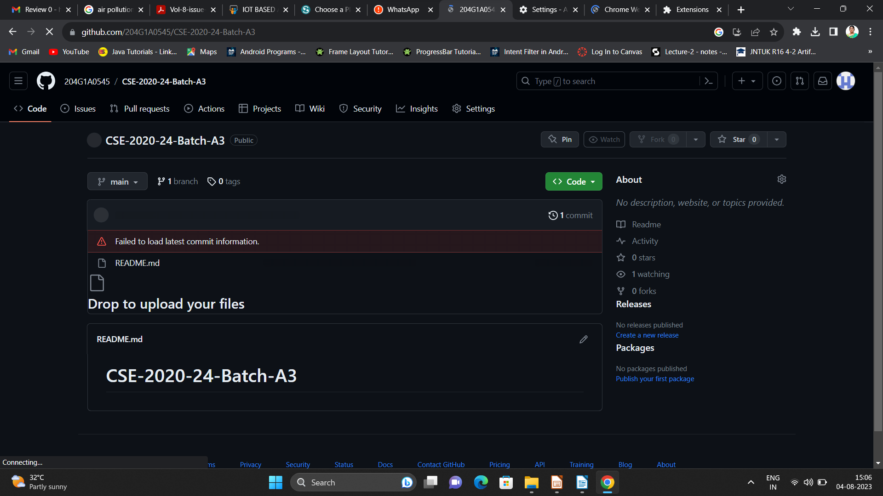

Git Hub Dashboards of each student
Repository Name Like: CSD 2024 – 25 Batch: A – XX
Under that project data upload literature survey papers, and son on..

Slide 9
Any Queries?

Slide 10
Thank You!!!

